Slide 1


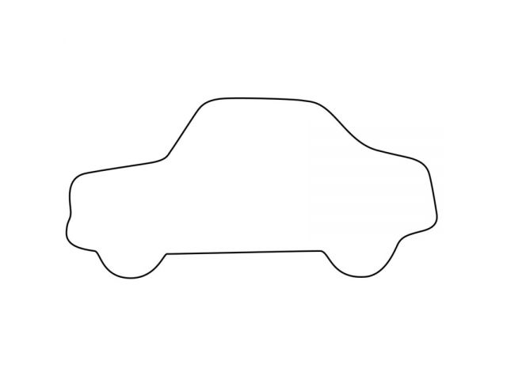
Controller
Speed
Sensor
Speed
Voltage
Position
Actuator
Throttle

